Slide 1
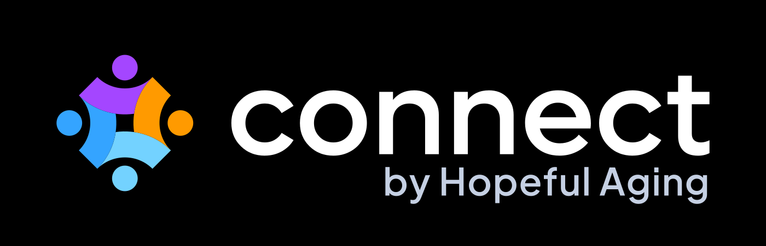

Engagement is the doorway.
Connection is the destination.
An engagement platform that brings people living with dementia together through conversation, active participation, and genuine human connection.
Notes:
Connect, by Hopeful Aging. Engagement is the doorway. Connection is the destination.

Slide 2






What makes Connect different?
WHY CONNECT
Active connection for everyone
Connection, proven through research
Connection you can see
Failure-free activities for every stage of dementia, including the people traditional programs leave behind.
Validated in a three-year, NIH-funded randomized controlled trial with a control group.
Staff track engagement participant by participant: who is connecting, and who we haven’t reached yet.
Connection as a philosophy
Connection that compounds
Personal from day one
Built on Dr. John Zeisel’s I’m Still Here approach and 30 years of research.
Participants shape, and even lead, activities for their peers.
A 5-minute assessment finds the best activities for each participant.

Slide 3




Runs on the screens you already have
ANY DEVICE
Tablets, computers, Fire TV, and Android TV. Nothing special to buy, and activities can be printed too.
Tablet
Computer
Fire TV
Android TV

Slide 4
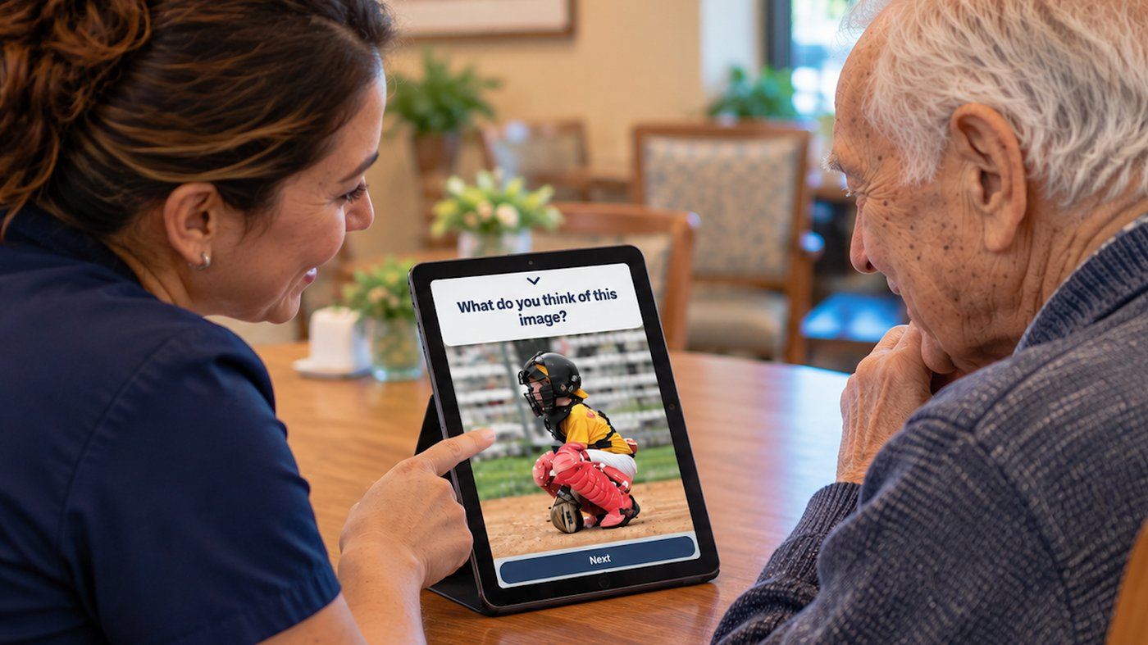
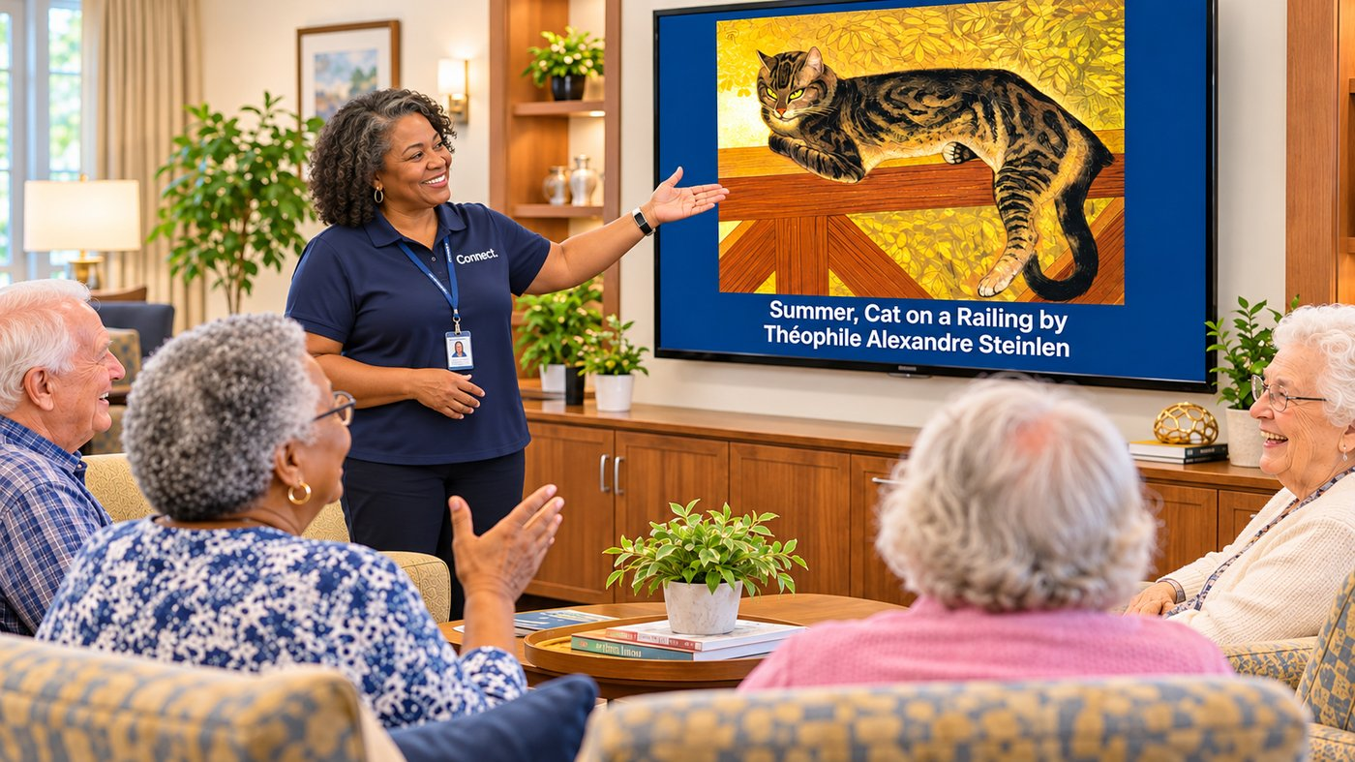
One-on-one, or the whole room
ANY SETTING
One-on-one. Share a tablet with a care partner, family member, or volunteer. Every activity comes with an easy facilitator guide.
Larger groups. Cast an activity to a TV so everyone can look, talk, and play together.

Slide 5
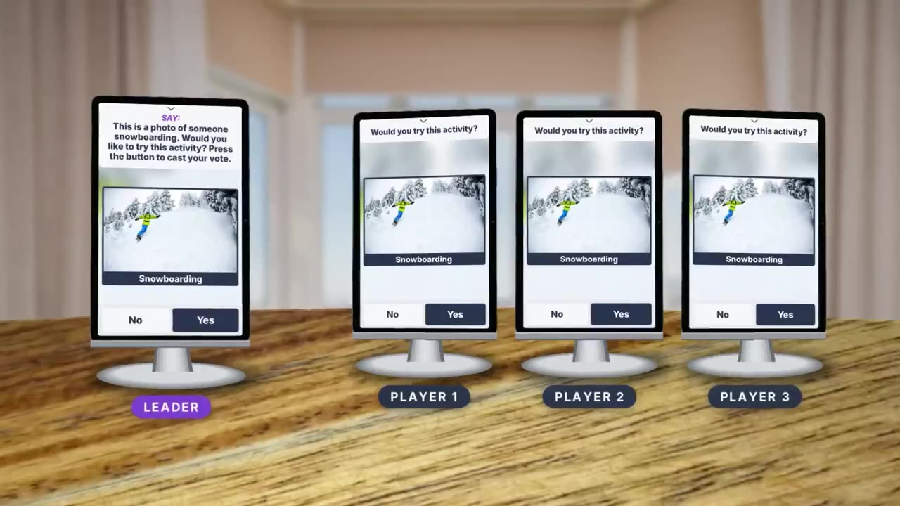
Everyone on their own tablet, all in sync
AUTOSYNC TECHNOLOGY · VIDEO
Notes:
Play the video. In It’s Your Choice, the leader reads the question, each player votes on their own tablet, and the group result appears on every screen at once.

Slide 6


Proven in a controlled clinical trial
PROOF BEFORE PROMISES
Compared with standard activities, participants using Connect were more engaged, more attentive, and far more likely to smile and laugh.
150%+
59%
83%
94%
more smiling and laughing
more attentive engagement
less distracted behavior
participant satisfaction, and 100% of staff
Three-year, NIH-funded randomized controlled trial
Participants living with dementia led sessions for their peers

Slide 7
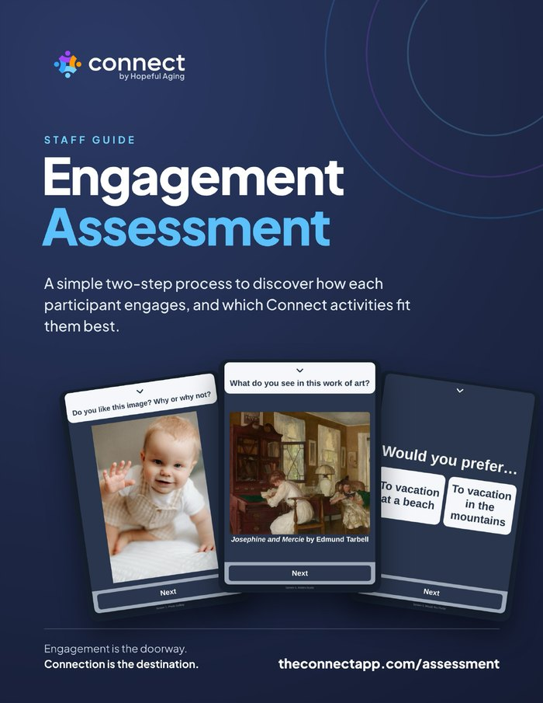
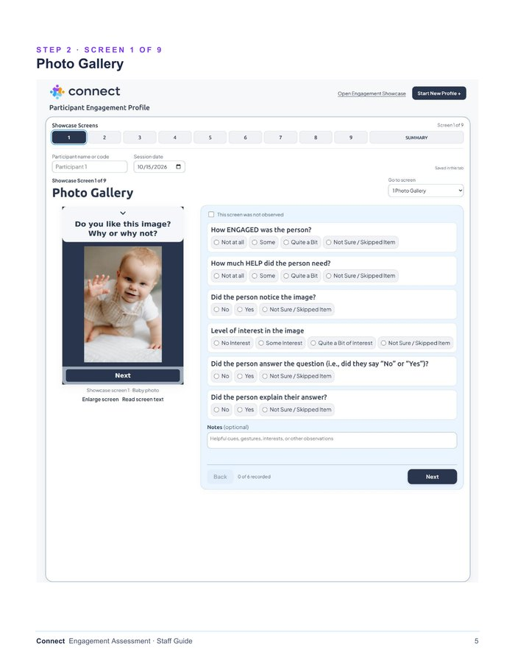
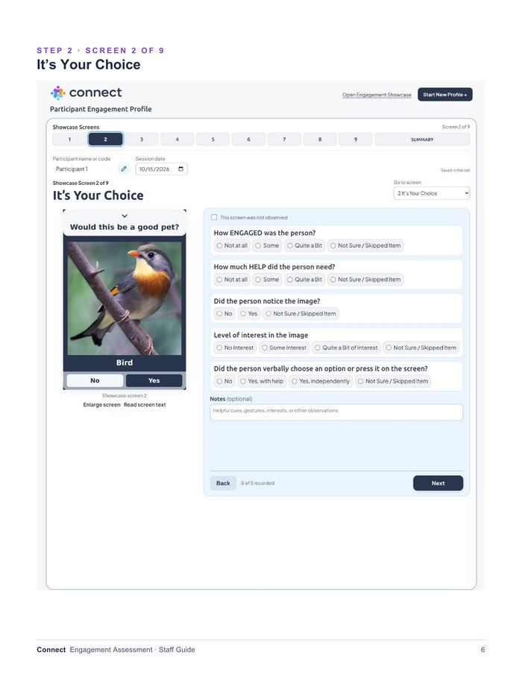

The Engagement Assessment
PERSONAL FROM DAY ONE
A simple two-step process to discover how each participant engages, and which Connect activities fit them best.
STEP 1
STEP 2
Engagement Showcase
Engagement Profile
Ten short screens on a tablet or computer. An enjoyable activity, not a test.
Record what you observed. Connect recommends the best-fit activities.
Done in one short session. About five minutes with the participant.
Needing help never lowers a score. It shapes how to support them.
Online or on paper. Email the profile, or print and save it.

Slide 8
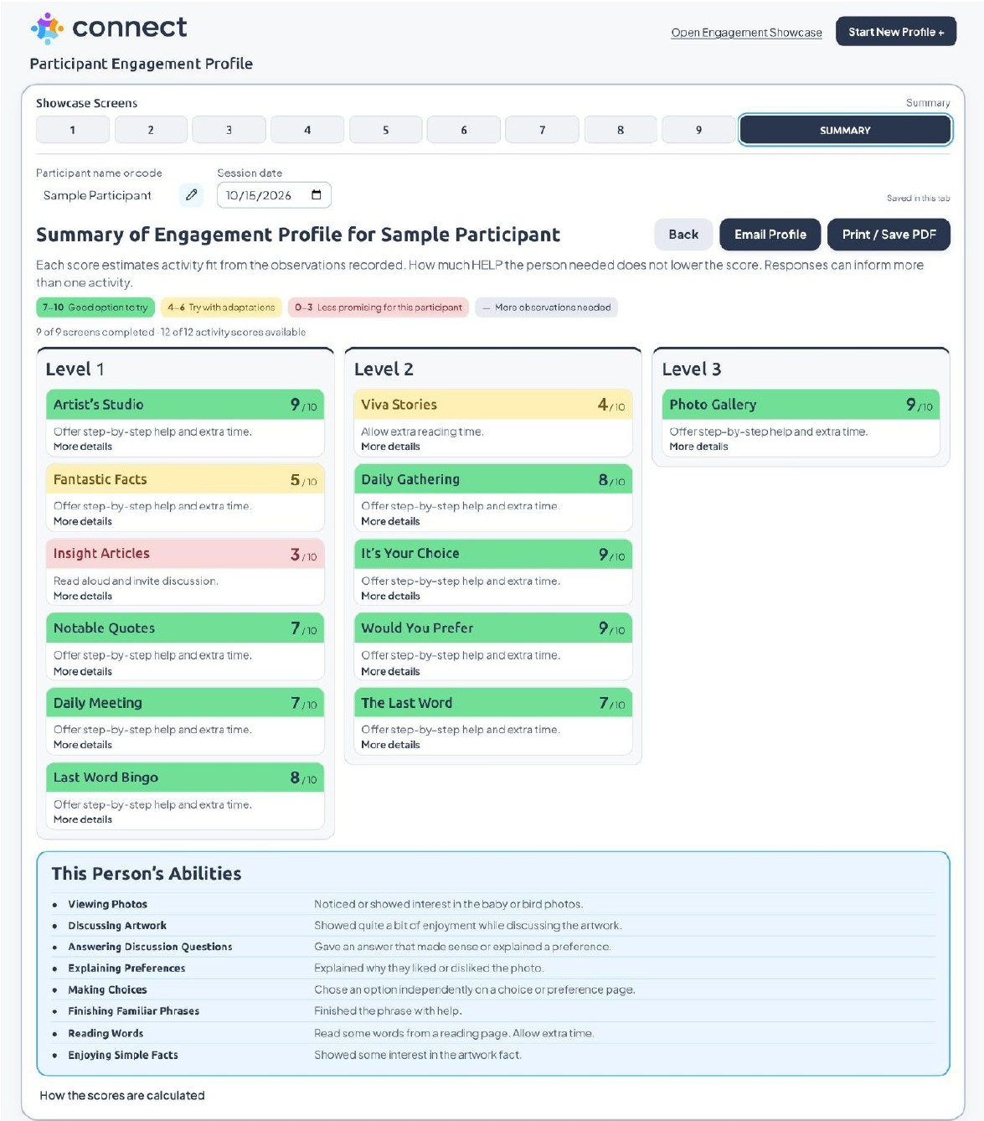
A clear plan for every person
SAMPLE COMPLETED SUMMARY
1
Every activity type, scored 0 to 10
Green means a good option to try. Yellow means try it with adaptations.
2
Grouped by level, with support tips
2
Each activity lists simple ways to help, like step-by-step cues or extra time.
1
3
This person’s abilities
What they did well, in plain language, from viewing photos to finishing familiar phrases.
7–10
Good option to try
4–6
Try with adaptations
3
0–3
Less promising
—
More observations needed

Slide 9
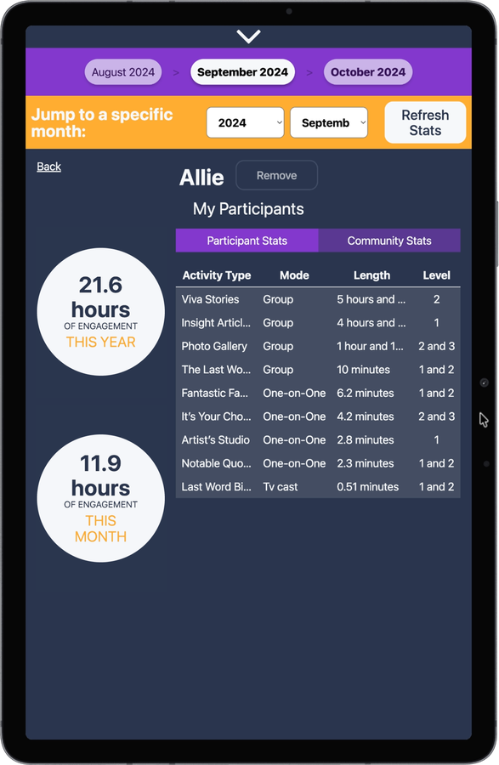
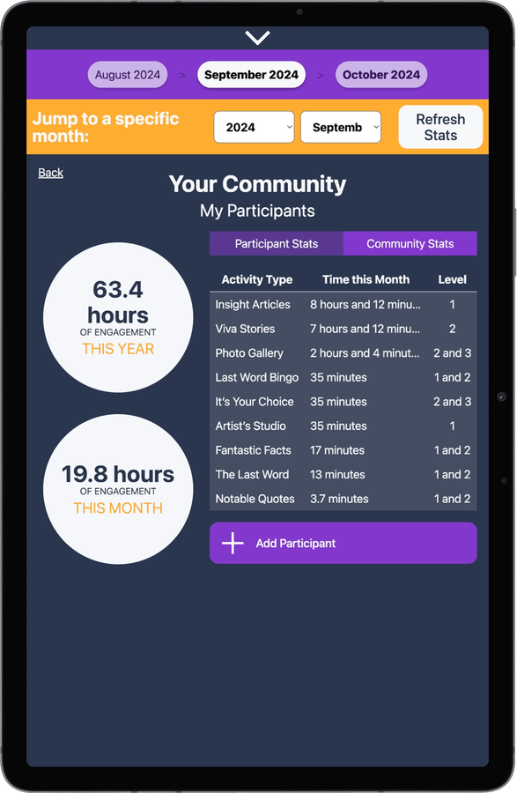
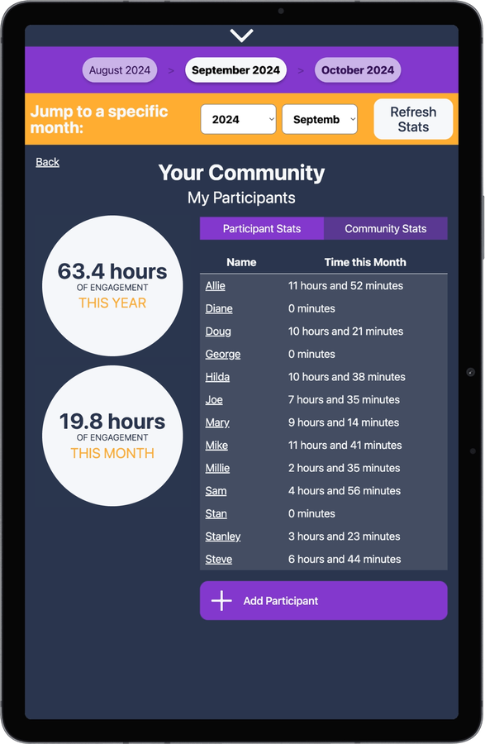
Connection you can see
REPORTING
Know who is connecting, and who we haven’t reached yet. Staff log in and mark who is taking part, with no passwords for participants to remember.
Each participant
Your whole community
Who needs a nudge
Hours this month and this year, by activity type and level.
See which activities your community uses most.
Spot participants with no time logged, so no one is left out.

Slide 10

See Connect in action
Scan or visit to book a demo
theconnectapp.com/demo
800-392-4870
READING LIBRARY
FULL PLATFORM
$24.99/mo
$49.99/mo
450+ readings for groups and one-on-one.
1,700+ activities across 12 types, new ones added monthly.
Pricing is per community.
NAAP and CDP members save 10% with code NAAP or CDP. Discounts available for organizations with multiple communities.

